Slide 1
Lecture 2: Mechanics
Content:
mechanics - basic terms and quantities
velocity and acceleration
force, moment of force, momentum
work, power
Newton’s laws
Kepler’s laws
Newton’s gravitational law
free fall, motion in gravitational field
mechanical energy

Slide 2
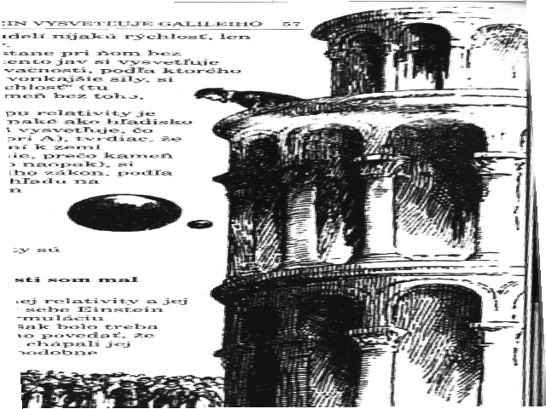
Classical mechanics

Slide 3
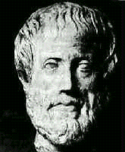
The Ancient Greeks
Aristotle (384-322 B.C.) is regarded as the first person to attempt physics, and actually gave physics its name.
On the nature of matter:
Matter was composed of:
Air
Earth
Water
Fire
Every compound was a mixture of these elements
There was no predictive aspect (science should have it – from the todays view)
and no need to verify statements by experiments.

Slide 4
On the Nature of Motion
Natural motion - like a falling body
Objects seek their natural place
Heavy objects fall fast
Light objects fall slow
Unnatural motion - like a cart being pushed
The moving body comes to a stand still when the force pushing it along no longer acts
The natural state of a body is at rest.

Slide 5
Aristotelian Physics
Aristotelian Physics was based on logic
It provided a framework for understanding nature
It was logically consistent
but it was wrong !!!
(from todays view)
Aristotelian physics relied on logic - not experiment!

Slide 6
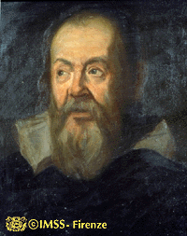
The Renaissance
Galileo Galilei (1564 -1642) was one of the first to use the scientific method of observation and experimentation. He laid the groundwork for modern science.
Observe
Abstract
Hypothesis
Prediction
Experiment

Slide 7
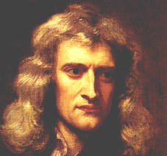
Classical Mechanics
Mechanics: the study of motion
Galileo (1564 -1642) laid the groundwork for Mechanics
Newton (1642-1727) completed its development (~almost~)
Newton’s Laws work fine for
Large Objects - Ball’s, planes, planets, ...
Small objects (atoms) → Quantum Mechanics
Slow Objects - people, cars, planes, ...
Fast objects (near the speed of light) → Relativity
Classical Mechanics - essentially complete at the end of the 19th Century
Later during the summer term we will come also
to specific/general relativity and quantum mechanics.

Slide 8
Classical mechanics
Galileo’s vs Newton’s understanding of inertia:
Galileo:
developed the idea of force, as a cause for motion
determined that the natural state of an object is rest or
uniform motion, i.e. objects always have a velocity,
sometimes that velocity has a magnitude of zero = rest.
objects resist change in motion, which is called inertia
Newton (further and more detailed understanding):
change in velocity = acceleration caused by force
inertia = resistance to change in motion – it is proportional
to the mass of the object and the acting force.

Slide 9
mechanics - basic terms and quantities
The general study of the relationships between motion, forces, and energy is called mechanics.
Motion is the action of changing location or position.
Motion may be divided into three basic types -translational, rotational, and oscillatory.
The study of motion without regard to the forces or energies that may be involved is called kinematics. It is the simplest branch of mechanics.
The branch of mechanics that deals with both motion and forces together is called dynamics and the study of forces in the absence of changes in motion or energy is called statics.

Slide 10
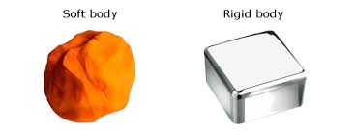
basic terms and quantities
Point (point mass) is a mass which doesn‘t have volume (mass focused into one point),
body (physical object) is an identifiable collection of matter, which may be more or less constrained to move together by translation rotation, or oscillation,
rigid body is an idealization of a solid body in which deformation is neglected,
barycentre is is the center of mass of two or more bodies that are orbiting each other,
trajectory - path that a moving object follows through space
as a function of time.

Slide 11
basic terms and quantities
Velocity: The velocity v of an object is the rate of change of its position with respect to a frame of reference, and is a function of time.
It is in general a vector quantity.
Its size (scalar value = speed) can be evaluated:
where s is path (distance) [m] and t is time [s].

Slide 12
velocity vs speed

Slide 13
velocity vs. speed
velocity is vector, speed is scalar

Slide 14
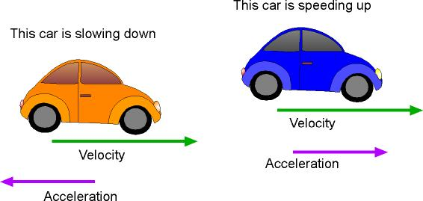
basic terms and quantities
Acceleration: is the rate of change of velocity (speed)
of an object.
It is in general a vector quantity.
Its size can be evaluated:
v is speed, s is path (distance) [m], and t is time [s].
Important equations:
where v₀ is the so called starting velocity.

Slide 15
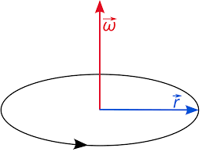
basic terms and quantities
Angular velocity: is the rate of change of angular displacement (angle) as a function of time.
It is defined for rotating bodies (because tangential velocity is a function of radius).
It is a vector quantity (pointing in the direction
of rotation axis).
Symbol:
Unit: radians per second [rad⋅s⁻¹]
Relationship between angular and
tangential velocity:
And normal acceleration:

Slide 16
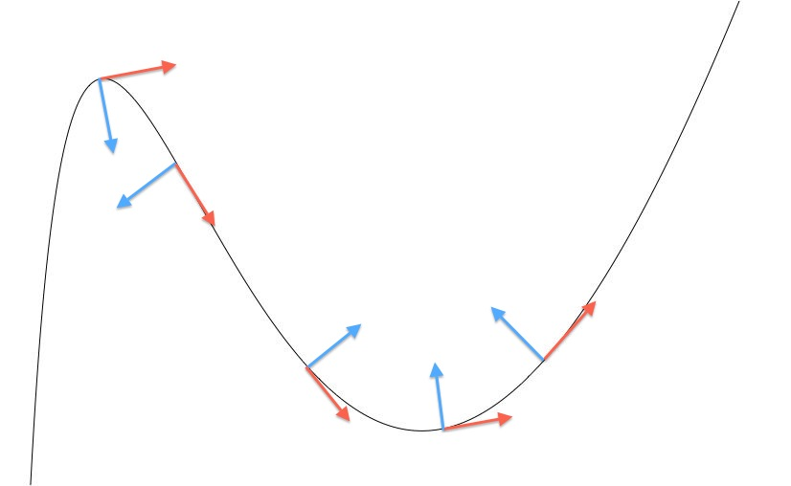
Tangent vs normal component
each vector of velocity and/or acceleration can be split into 2 perpendicular components along a curvilinear path:
tangent component (e.g. a_{t})
(connected with the change of the vector size)
normal component (e.g. a_{n})
(connected with the change of vector direction)

Slide 17
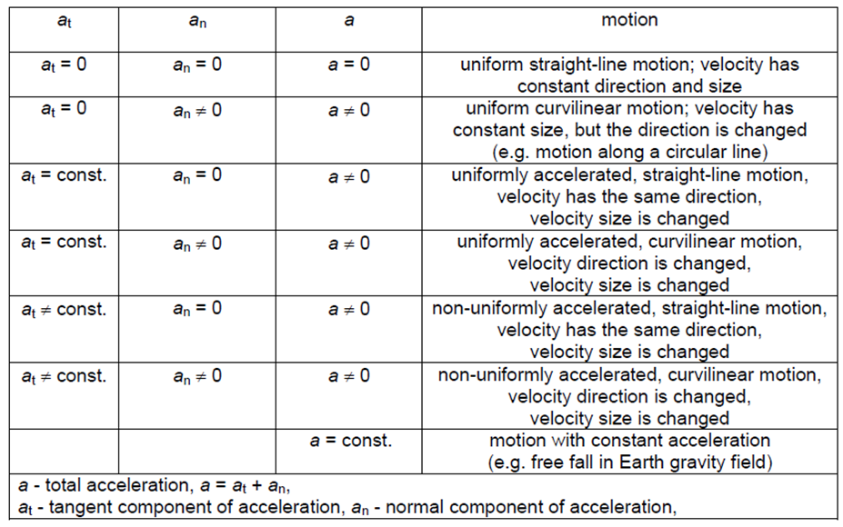
classification of motions

Slide 18
basic terms and quantities
Mass (weight):
Mass is both a property of a physical body and a measure of its resistance to acceleration (a change in its state of motion) when a force is applied.
inertial mass measures an object's resistance to being accelerated by a force (represented by the relationship F = ma).
gravitational mass (weight) measures the gravitational force exerted on an object in a known gravitational field.
Comment: Mass of an object should be the same on the Earth
and Mars, but the weight will be different.
Unit: [kg]
Its definition has to be changed due to the problems
with the international prototype.
It is a scalar quantity.

Slide 19
mass vs. weight

Slide 20
mass vs. weight
mass is independent from gravity field

Slide 21
basic terms and quantities
Force: is any interaction that, when unopposed, will change the motion of an object (Galileo).
It will change its velocity (Newton).
If the mass of the object is constant, this law implies that the acceleration of an object is directly proportional to the force acting on the object (in the direction of the force).
Its size can be evaluated (2. Newton‘s law):
where m is mass [kg] and a is acceleration [m·s⁻²].
It is a vector quantity. Unit [N] is called Newton.

Slide 22
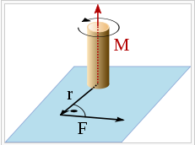
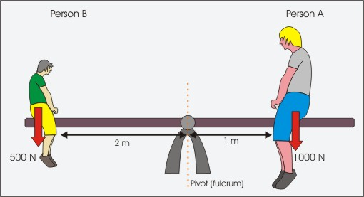
basic terms and quantities
Moment of force: is the product of a force and its distance from an axis, which measures the rotation effect of the force (about that axis).
In general it is a combination of a physical quantity and a distance.
where is force [N] and
is distance vector [m].
It is in general a vector quantity.

Slide 23
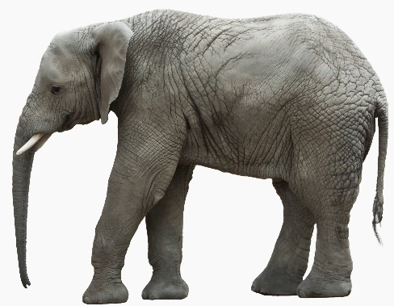
basic terms and quantities
Momentum: is the product of the mass and velocity of an object. It is connected with the kinematic energy of the moving object.
It is in general a vector quantity.
where m is mass [kg] and v is velocity [m·s⁻¹].
≠

Slide 24
basic terms and quantities
Pressure: Pressure is the amount of force acting per unit area.
where F is the size of normal force [N] and a is the
area of the surface on contact [m²].
Unit is pascal [Pa] = [N/m²] = [kg⋅ s⁻²⋅m⁻¹].
Old unit was bar (1 bar = 100 000 Pa).
It is a scalar quantity.
Comment: In some physical applications, pressure can be connected
with the direction of the acting force, we speak then about
tensors of strain and stress

Slide 25
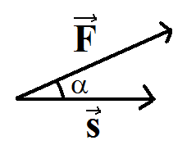
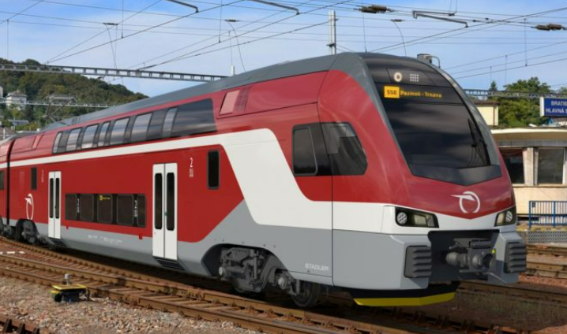
basic terms and quantities
Mechanical work:
In mechanics, a force is said to do work W if, when acting on a body, there is a displacement of the point of application in the direction of the force.
It size is given by the product of force and distance.
Unit of work is joule [J] = [N⋅m] = [kg⋅m²⋅s⁻²].
Mathematically it is a scalar product of force and distance (vectors):
Size of scalar product is given:
It is a scalar quantity.

Slide 26
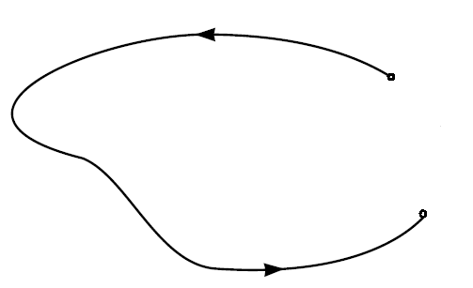
basic terms and quantities
Mechanical work:
But what to do, when the trajectory
is not straight, but of irregular shape?
We can divide it into N small parts
and evaluate work for each of them:
… and when the size of these small parts will be very small…?
where is the path and its differential
(very small part).

Slide 27
basic terms and quantities
Power:
Power is defined as the rate at which work is done upon an object. Like all rate quantities, power is a time-based quantity.
It is evaluated as the ration of work and time:
where W is work [J] and t is time [s].
Unit of power is watt [W] = [J⋅s⁻¹] = [kg⋅m²⋅s⁻³].
It is a scalar quantity.

Slide 28
Lecture 2: Mechanics
Content:
basic terms and quantities
velocity and acceleration
force, moment of force, momentum
work, power
Newton’s laws
Kepler’s laws
Newton’s gravitational law
free fall, motion in gravitational field
mechanical energy

Slide 29
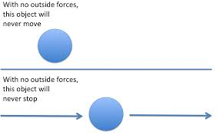
Newton’s three laws of motion:
I. Every object in a state of uniform motion tends to remain
in that state of motion unless an external force is applied to it.
This we recognize as essentially Galileo's concept of inertia, and this is often termed simply the "Law of Inertia"
(inertia is the tendency of matter to resist changes in its velocity).

Slide 30
Newton’s three laws of motion:
II. The relationship between an object's mass m, its acceleration
a, and the applied force F is: F = ma or
Acceleration and force are vectors; in this law, directions
of the both vectors is the same. Simply the "Law of Power"
This is the most powerful of Newton's three Laws, because it allows quantitative calculations of dynamics: how do velocities change when forces are applied.
Notice the fundamental difference between Newton's 2nd Law and the dynamics of Aristotle: according to Newton, a force causes only a change in velocity (an acceleration); it does not maintain the velocity as Aristotle held.
Thus, according to Aristotle there is only a velocity if there is a force, but according to Newton a force acts on it to cause an acceleration (that is, a change in the velocity).

Slide 31
Newton’s three laws of motion:
II. The relationship between an object's mass m, its acceleration
a, and the applied force F is: F = ma or
Acceleration and force are vectors; in this law, directions
of the both vectors is the same.
Physical quantities and units:
[m] = kg
[a] = m⋅s⁻² (change of velocity with respect to the time)
[F] = N = kg⋅m⋅s⁻²
Comment: velocity and acceleration defined by means of derivatives:

Slide 32
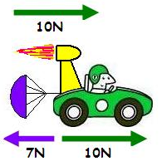
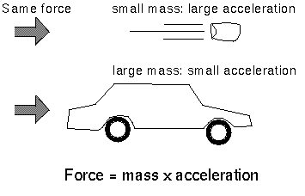
Newton’s three laws of motion:
II. The relationship between an object's mass m, its acceleration
a, and the applied force F is: F = ma or
Acceleration and force are vectors; in this law, directions
of the both vectors is the same.

Slide 33
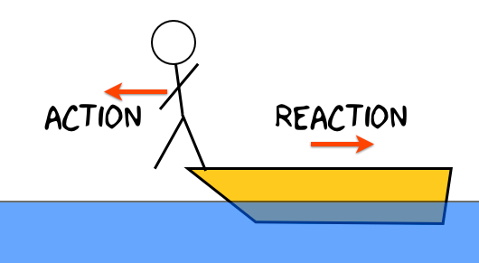
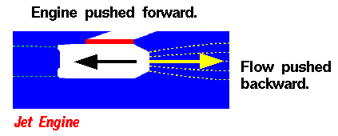
Newton’s three laws of motion:
III. For every action there is an equal and opposite reaction.
This is often termed simply the "Law of action and reaction".
This law is exemplified by what happens if we step off a boat
onto the bank of a lake: as we move in the direction of the shore,
the boat tends to move in the opposite direction
(leaving us facedown in the water, if we aren't careful!).

Slide 34
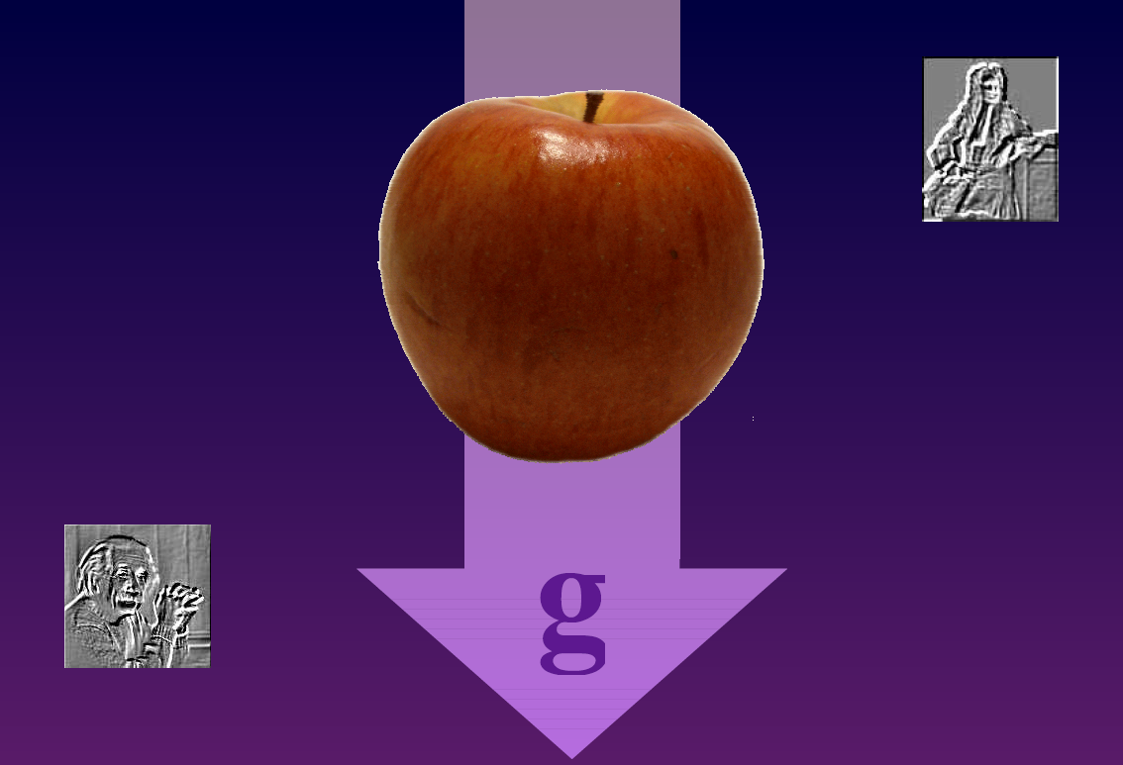
gravitation

Slide 35
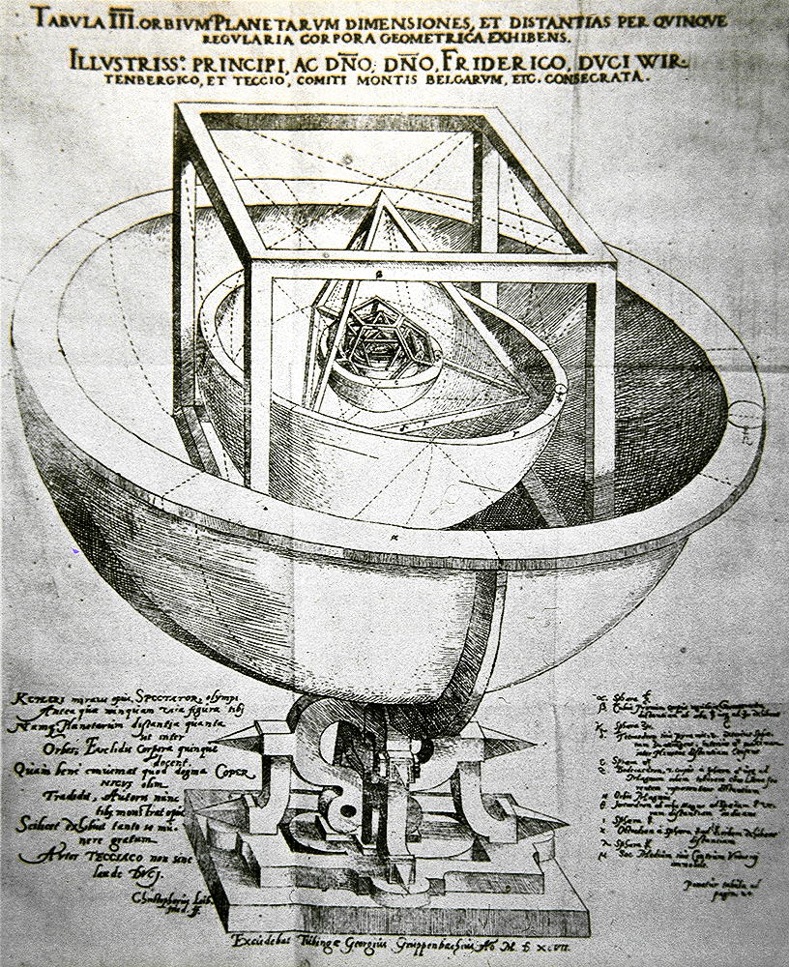
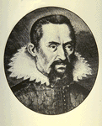
Kepler’s Work
Tycho Brahe led a team which collected data on the position of the planets (1580-1600 with no telescopes).
mathematician Johannes Kepler was hired by Brahe to analyze the data.
he took 20 years of data on position and relative distance.
no calculus, no graph paper, no log tables.
both Ptolemy and Copernicus were partly wrong.
he determined three laws of planetary motion (1600-1630).
Johannes Kepler
1571 - 1630

Slide 36
1. Kepler’s First Law
The orbit of a planet is an ellipse with the sun at one focus.
A path connecting the two foci to the ellipse always has the same length.

Slide 37
2. Kepler’s Second Law
The line joining a planet and the sun sweeps equal areas in equal time.
Δt
The planet moves slowly here.
Δt
The planet moves quickly here.

Slide 38
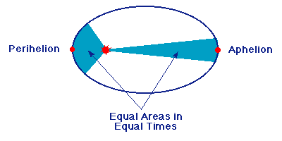
2. Kepler’s Second Law
The line joining a planet and the sun sweeps equal areas in equal time.

Slide 39
3. Kepler’s Third Law
The square of a planet’s period is proportional to the cube of the length of the orbit’s semimajor axis.
T²/a³ = constant
The constant is the same for all objects orbiting the Sun
direction of orbit
semimajor axis: a
The time for one orbit is one period: T

Slide 40
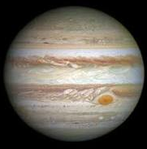
Kepler’s Third Law
Example: planets Earth and Jupiter.
Jupiter’s period is 11.86 year (11,86-times period of Earth), semimajor axis (compared to Earth) is 5.2-times larger. So, it should be valid:
T²/a³ [Earth] = T²/a³ [Jupiter]
1²/1³ = (11.86)²/(5.2)³
(5.2)³/1³ = (11.86)²/1²
140.608 ≈ 140.659

Slide 41
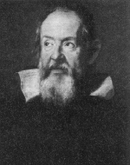
Work of Galileo Galilei
various contributions to
the concept of modern science,
mathematical derivations,
astronomical observations,
engineering experiments,
free fall experiments
(velocity is independent from the body mass
- a contradiction to Aristotelian physics).
Galileo Galilei
(1564 - 1642)
Very nice trial (Brian Cox, vacuum chamber):
https://www.youtube.com/watch?v=E43-CfukEgs&feature=youtu.be
Experiment on the Moon (Apollo 15):
https://upload.wikimedia.org/wikipedia/commons/transcoded/e/e8/Apollo_15_feather_and_hammer_drop.ogv/Apollo_15_feather_and_hammer_drop.ogv.240p.webm

Slide 42
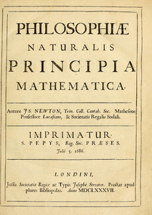
Newton’s Work
laws of motion
universal law of gravity
mathematical derivation of Kepler’s laws
introduction of calculus (derivatives)
most important work:
Philosophiæ Naturalis Principia Mathematica ("Mathematical Principles of Natural Philosophy"), first published 5 July 1687
(later edited versions: 1713 and 1726)
he spent the second half of his life in Royal mint
Isaac Newton
1643 - 1727

Slide 43
Universal law of gravity
M
m
r
F ∝ m
F ∝ M
Proportionality constant:
1
r²
F ∝
“Newton’s Constant”
mM
r²
mM
r²
combine:
F ∝
F = G
Comment:
This property (1/r²) was emphasized before Newton by Robert Hook and Ismaël Boulliau.

Slide 44
Universal law of gravity
M
m
r
Newton's law of universal gravitation states that any two bodies
in the universe attract each other with a force that is directly
proportional to the product of their masses (m, M) and inversely
proportional to the square of the distance between them (r).
G – is universal gravitational constant
(estimated for the first time by H. Cavendish in 1797-1798)

Slide 45
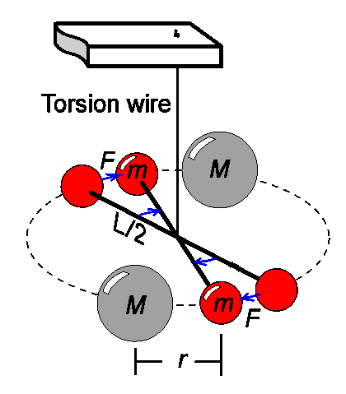
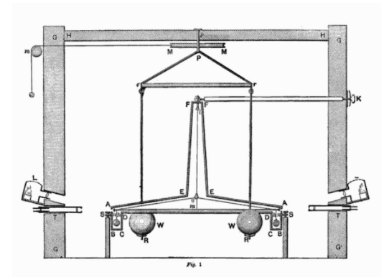
Measuring gravity force between “ordinary-sized” objects is very hard
Cavendish’s value:
today:

Slide 46
gravitational acceleration (g):
Newton’s gravity law:
2. Newton’s motion law:
[m⋅s⁻²]
Value of g?
In our country approx. 9.81 m⋅s⁻² (rounded 10 m⋅s⁻² ).
It is not a constant! Its value is influenced by many factors
(rotation of Earth, distance from Earth center, large masses
on the surface or below it).
But in the same place on the Earth it acts on falling object
independently on their mass (in vacuum).

Slide 47
gravitational acceleration (g):
Estimation of the g value for our Earth:
(mass of the Earth ~ 5.97⋅10²⁴ kg; radius ~ 6371000 m,
G ~ 6.674⋅10⁻¹¹ N⋅m²/kg²)
[m⋅s⁻²]
In one point at the Earth surface g value is constant (independent from the mass),
but it changes with the change of position (!)

Slide 48
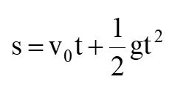
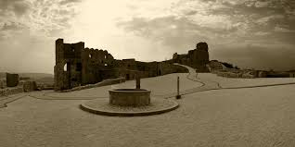
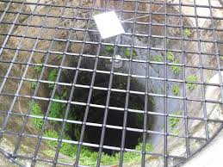
free fall
exact derivation
is in the appendix
of this lecture
When we take v₀ = 0 (velocity for time t = 0), we get the well known formula:
change of the velocity
Example:
t₁= 1 sec ⇒ s₁ = 0.5 g t₁² = 5 ⋅1 = 5 m
t₂= 2 sec ⇒ s₂ = 0.5 g t₂² = 5 ⋅4 = 20 m
t₃= 3 sec ⇒ s₃ = 0.5 g t₃² = 5 ⋅9 = 45 m
t₄= 4 sec ⇒ s₄ = 0.5 g t₄² = 5 ⋅16 = 80 m

Slide 49
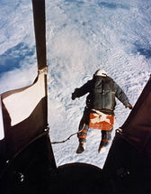
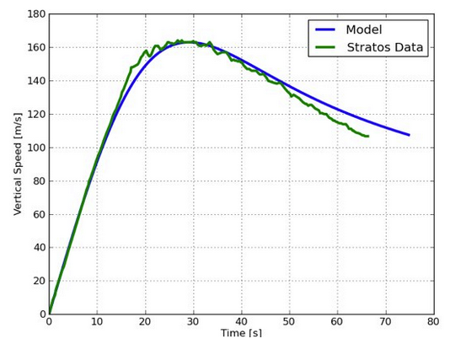
free fall
Example: jump of Felix Baumgartner (2012)
height: 38 969 m
time: 4 min 20 sec.
Can we check it by means of free fall formula?
Air resistance:
where k is the air
resistance coefficient
k = 0.24 [kg/m]

Slide 50
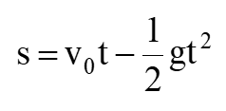
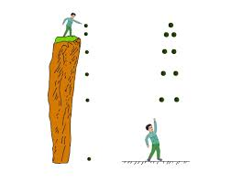
vertical throw
change of the velocity
The motion is damped, until v = 0 and from this moment a free fall starts.
free fall vertical throw

Slide 51
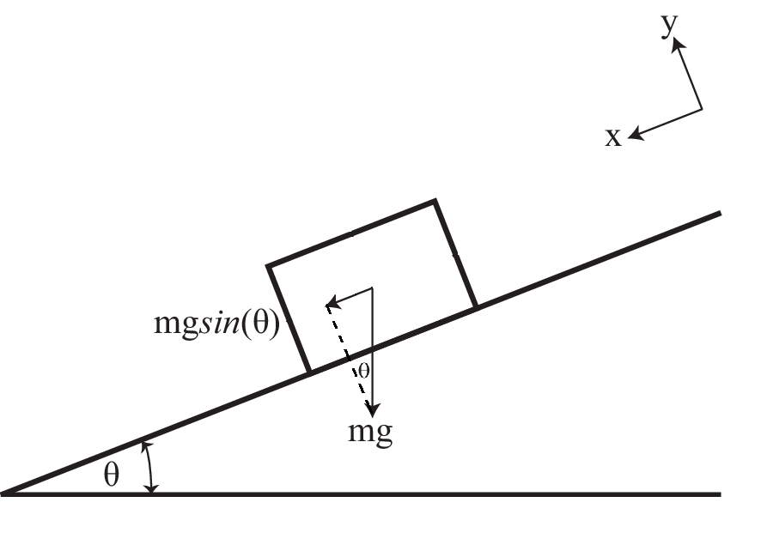
motion along inclined plane (without friction)
F_{G} = mg
From the figure it follows:
a = F_{G}/m = (F_{G}sinθ)/m =
= (mgsinθ)/m = gsinθ
From this derivation and also from experiments it follows
that the accelerated motion along inclined plane is also
independent from the body mass.
Valid e.g. in models of water transport on slopes in hydrology.
Comment: This is not valid in a case of rolling of an object.

Slide 52
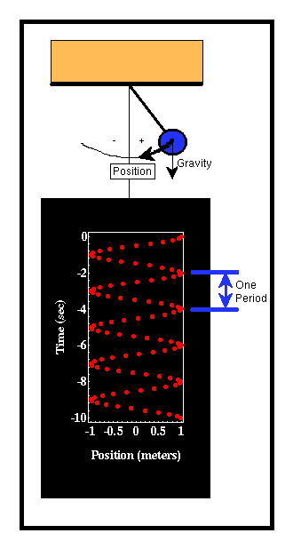
period of a mathematic pendulum (T):
Is also independent on the mass of the object, it is a function of the length L and gravitational acceleration g:
L
Walter Lewin – lecture at MIT
(video),
L = 5.21 m, g = 9.8 m/s²,
T = 4.58 s
http://www.youtube.com/watch?v=KXys_mymMKA

Slide 53
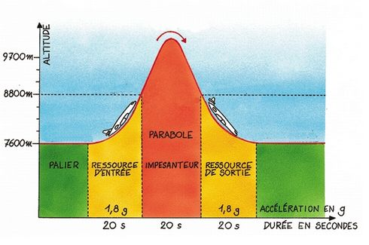
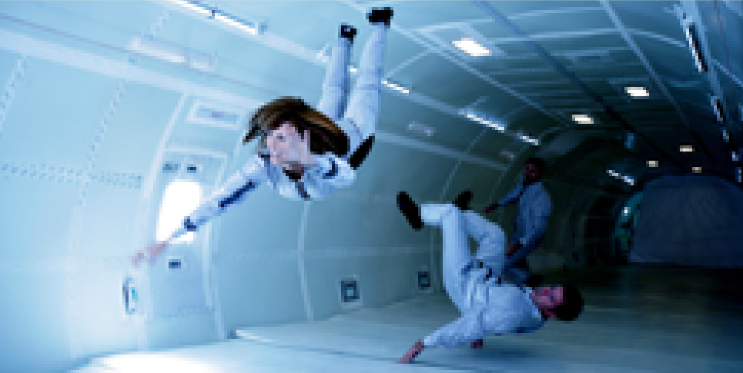
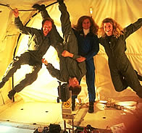
zero G parable
simulation of weightless stage (in an aircraft)
used also for commercial purposes:
http://www.gozerog.com

Slide 54
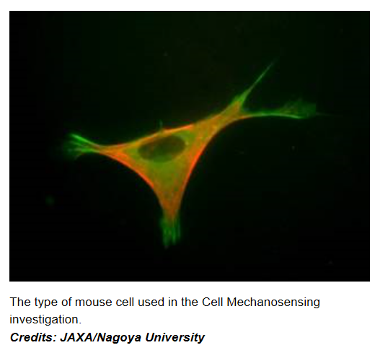
Example: gravity and biology
Weightless stage – and its influence on muscles function
Muscle cells have unique ways of detecting mechanical stress. Scientists think that the lack of mechanical stress on cells from gravity may decrease tension in the cell membrane and affect the expression of key proteins and genes, ultimately leading to muscle atrophy.

Slide 55
Lecture 2: Mechanics
Content:
mechanics - basic terms and quantities
velocity and acceleration
force, moment of force, momentum
work, power
Newton’s laws
Kepler’s laws
Newton’s gravitational law
free fall, motion in gravitational field
mechanical energy

Slide 56
back to basic terms and quantities
Mechanical energy:
It is the energy associated with the motion and position of an object:
kinetic energy (E_{k}),
potential energy (E_{p}).
In so called conservative fields the sum of potential energy and kinetic energy is constant.
Additional energies in mechanics:
energy of rotation body,
elastic energy.
Unit of energy is identical with the unit of mechanical
work (joule) [J].

Slide 57
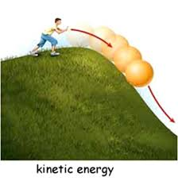
basic terms and quantities
Mechanical energy:
kinetic energy (E_{k}) - the energy that it possesses due to its motion.
where m is the mass [kg] and
v the velocity [m⋅s⁻¹].
This is valid in classical mechanics.
In relativistic mechanics, this is a good approximation only when v is much less than the speed of light.

Slide 58
kinetic energy - derivation:
velocity:
Energy is connected with work:
for:
acceleration:
and:
is valid:

Slide 59
kinetic energy - derivation:
Energy is connected with work:
for:
is valid:
and:
is valid:
But where we got the ½ in the result?:
⇒
We have ignored the term (Δv)² , because it is a very small number
(e.g. 0.01² = 0.0001).
Final expression:
Generally:

Slide 60
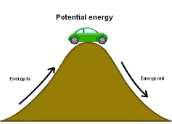
basic terms and quantities
Mechanical energy:
potential energy (E_{p}) - the energy that an object has due to its position in a force field (mostly gravitational field).
where m is the mass [kg],
g the gravitational acceleration [m⋅s⁻²]
and h the height [m].
The change of potential energy is dependent only from the height difference between two points and not from the trajectory of the motion between them.

Slide 61
basic terms and quantities
Moment of inertia: is a measure of an object's resistance to changes in the rotation direction.
For a point mass it can be expressed as:
where r is the distance of the point mass from the rotation axis.
Energy of rotating body:
where ω is the size of angular velocity.

Slide 62
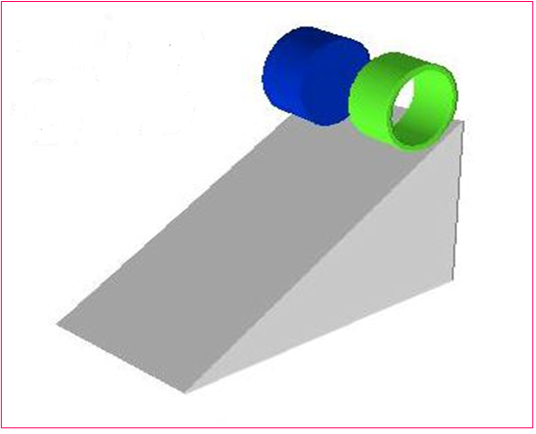
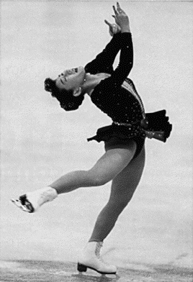
Energy of rotating body:
identical masses
different distances of masses from the centre
c) which one will move faster (will have higher ω)?

Slide 63
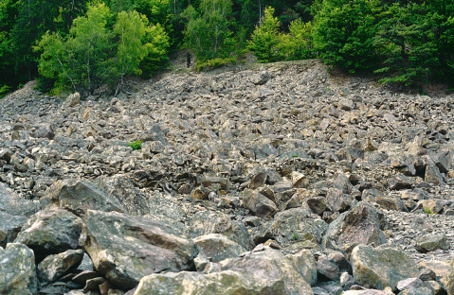
Energy of rotating body:
rocky landslip in Vyhne (central Slovakia)
- so called gravitational separation
(largest pieces at the bottom of the slope)

Slide 64
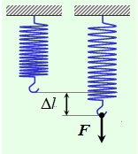
basic terms and quantities
Mechanical energy:
Elastic energy (E_{El}) - is the potential mechanical energy stored in the configuration of a material or physical system as work is performed to distort its volume or shape. Elastic energy occurs when objects are compressed and stretched, or generally deformed in any manner.
where k is so called spring constant and
Δl is the length change of the spring.

Slide 65
Appedix 1 – derivation of the free-fall equations
(using integration)

Slide 66
free fall – basic equations (1/2)
From the definition of velocity and acceleration it follows:
Integrating this equation with respect to t, we get:
Accepting the original condition that
for the time t = 0 the initial velocity
of the object at some level z₀ is v₀,
we get: c₃=−v₀.

Slide 67
free fall – basic equations (2/2)
In further step we integrate this equation again with respect to t:
Accepting the original condition that
for the time t = 0 the position of the object
is the level z₀ we get: c₇= z₀.

Slide 68
Appedix 2 – derivation of the period
for a mathematical pendulum

Slide 69
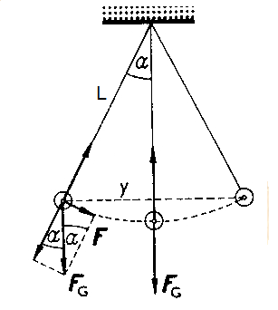
mathematical pendulum
The main force, causing the movement
is connected with the action of gravity force:
From the main triangle (picture) it is valid (α<5°):
And we use also following relations:
Starting with Eq. (1):
We know from the rotational motion:
where: ω is the angular velocity and T period.
Setting this into Eq. (2) we obtain:

